Slide 1
Indoor Street View Terence Zhao
Business Opportunity Include problem statement, project description, context, opportunity, challenges, recommendation
As more of the world becomes digital, even physical spaces can now be explored online. This provides widespread accessibility and convenience for customers who want to preview our stores. The Indoor Street View project takes advantage of popular technologies such as Google Maps and enhances them with our own SKIN (Sears Kmart Indoor Navigation) technology to allow users to experience our stores as if they were really there. By providing the immersive experience of navigating indoor locations, we are creating a new format for shopping online and paving the way for the store of the future.
Project Overview
Overview of the initiative
Allows management to view store layouts in perspective
Gives end-users immersive interface to shop virtually online
Your role and accomplishments
Implemented front end web application using Google Maps API
Captured panoramic images of Sears Woodfield Mall
Stitched and processed images for indoor street view
Integrated existing SKIN map technologies
Built workflow tools to support project development
Developed web based application to work with mobile
Next steps
Automate processes using robotics and store builder interface
Integrate with augmented reality project to allow users to shop virtually
Provide detailed zoom level that displays 3D models of shelves and items
Success Metrics/Timeline
Deliverables with timeline
Use $ returns as much as possible
Create a custom street view using panoramic images of indoor location
Take panoramic images of select locations at multiple zoom levels
Stitch images together using photographic software
Split panoramas into image tiles that follow naming convention
Link indoor street view objects together on map so they can be traversed
Choose which geo-locations to have street view on store map
Manage incoming and outgoing paths from each ISV location
Overlay arrow buttons to move from one street view to another
Refine user interface to leverage indoor street view functionality
Combine map and street view side-by-side for better orientation
Place markers to identify significant locations in street view & map
Provide high level of zoom detail so products can be identified
Port web view application to mobile device framework using web view
Should maintain user experience and functionality
Compatibility with all major mobile platforms
Project Objectives (Optional)
What is the expected outcome of the project?
Goals
Create panoramic images at different zoom levels (headings)
Define which locations on indoor map to provide street view
Use Google Maps Javascript API v3 to add ISV to SKIN map
Enhance street view detail by adding multiple zoom levels
Link geo-locations with street view together following map path
Success Metrics
Create an efficient workflow for generating quality panoramas
Choose street view locations so there is not significant overlap
Maintain high quality images and transitions at all zoom levels
Demo working prototype on web browser and android device
Optional box
Other projects
Future Opportunity
Next steps
Dynamically load panorama images based on location on floor map
Interacts with floor map to change panorama based on current location
Current implementation of indoor street view for small businesses do not show where users are indoor on a floor map

Slide 2
Business opportunity
Notes:
As more of the world becomes digital, even physical spaces can now be explored online. This provides widespread accessibility and convenience for customers who want to preview our stores. The Indoor Street View project takes advantage of popular technologies such as Google Maps and enhances them with our own SKIN (Sears Kmart Indoor Navigation) technology to allow users to experience our stores as if they were really there. By providing the immersive experience of navigating indoor locations, we are creating a new format for shopping online and paving the way for the store of the future.

Slide 3
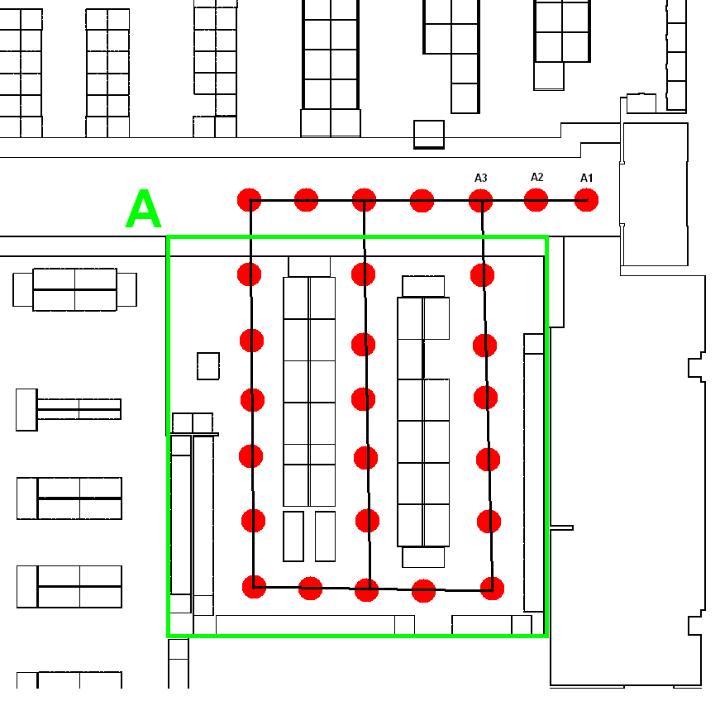
Plan Locations
Scout for main departments and aisles
Identify paths within each department
Pick locations about 2 feet apart
Plot and label each location on map

Slide 4
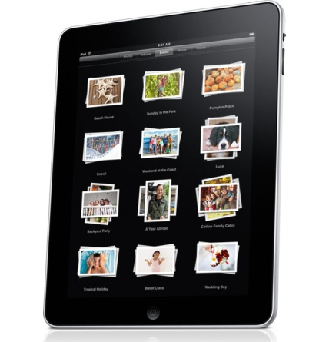
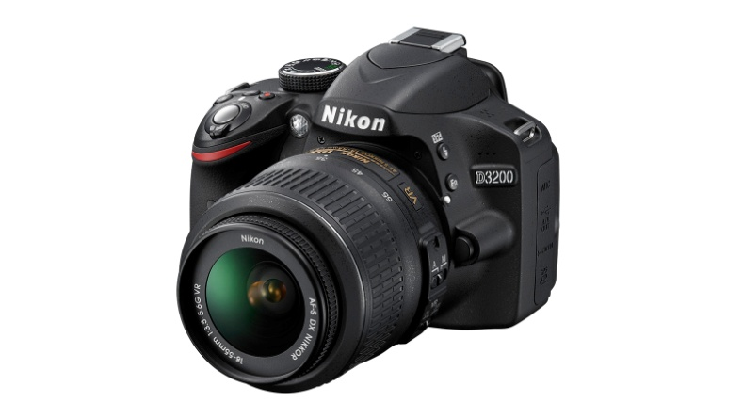




Creating Panoramic Images
Take images by hand by panning
Low resolution images
Stitches automatically
Free panorama apps
Use tripod & wide angle lens
24 images for each panorama
High resolution images
Requires Stitching Software
Photosynth
360 Panorama
Microsoft ICE
Hugin

Slide 5
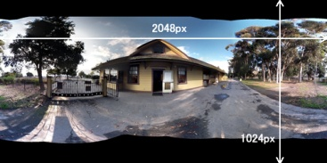
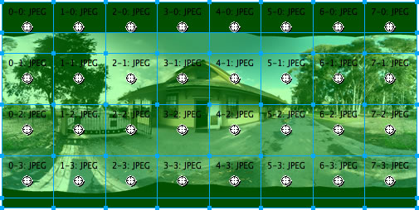
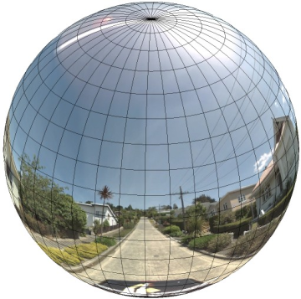
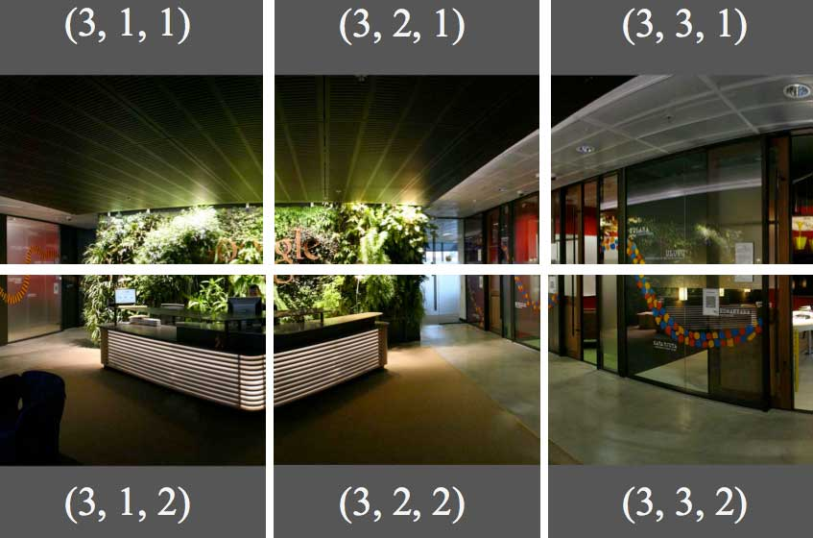
Processing Images
Resulting images must be 2:1 ratio
Cut images for zoom levels
lobby_3_1_1.jpg
lobby_3_2_1.jpg
lobby_3_3_1.jpg
…
Naming Convention:
'http://skin-dev.searshc.com/Skin20ISV/1570/'+pano+‘-tiles'+'/'+pano+'_'+zoom+'_'+tileX+'_'+tileY+'.jpg'

Slide 6
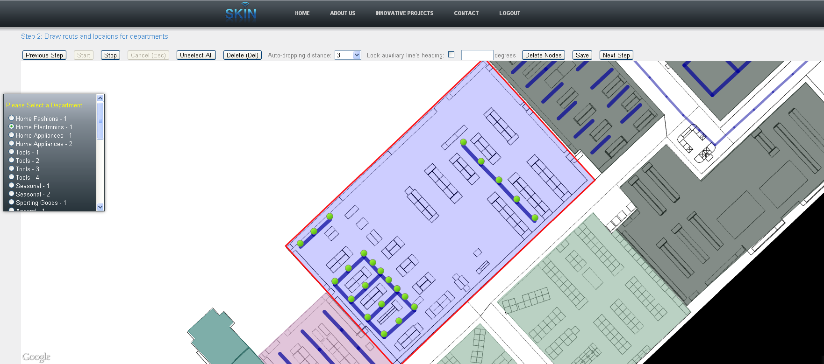
Generic Builder Interface
A tool we used to add locations to the database
Allows us to draw points and paths for each department

Slide 7
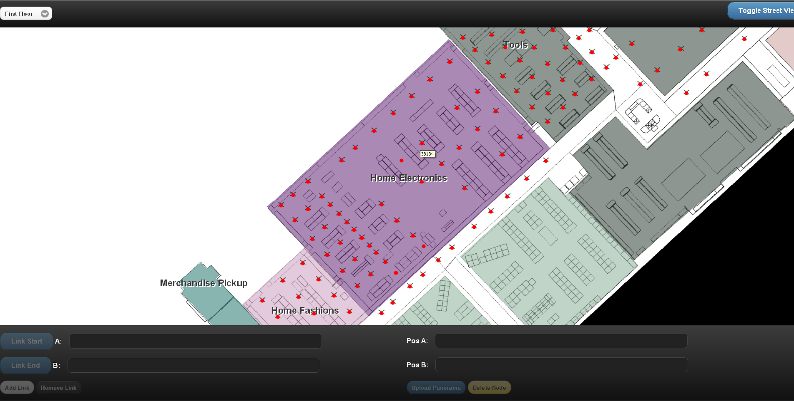
Street View Builder Interface
Uploads panoramas to server
Attaches panorama to a location id
Creates links between panoramas
Preview street vuew
Adjust headings

Slide 8
Opportunity and Challenges
Opportunity:
B2C - First mover in retail to offer virtual tour of the store with integrated deals.
B2B - Opportunity to patent the process and offer as a service to other businesses(Eg: Malls, Airport)
Allows Sears to push new in-store initiatives to users using a virtual tour and draw customers to their stores. (Eg: Fit Studio)
Gives the customers an opportunity to view the store online and review the products.
Challenges:
Scaling process to hundred of stores
Maintaining privacy of customers captured in panoramas
Adapting to constantly changing floor plans

Slide 9
Accomplishments
Designed an end-to-end process to create Indoor Street View
Reviewed various softwares and applications that can be used
Integrated Google Maps API with SKIN
Built Street View tool(Associate App) to support project development
Developed web based application to work with mobile
Developed a platform to integrate deals from ShopLocal with Street View
Used all the knowledge gained to develop a working model of Indoor street view for Sears Store in Woodfield
Implemented front end web application using Google Maps API
Captured panoramic images of Sears Woodfield Mall
Stitched and processed images for indoor street view
Integrated existing SKIN map technologies

Slide 10
Next Steps/ Future Roadmap
Integrate with Planogram to identify location of each product and add product specific deals
Automate processes using robotics and store builder interface
Provide detailed zoom level that displays 3D models of shelves and items
Integrate with augmented reality project to allow users to shop virtually
Allow users to scan any view in the store with mobile device and receive information, deals, direction, etc. by matching image data against panoramas.

Slide 11
Our Learnings

Slide 12
Acknowledgements
Panorama clicking Team - Brian, Peng, Xiaomei, Harsh Woodfield Maps - Brian, Harsh, Kamran Woodfield Builder Interface - Cheng-Hsin Web Services - Mamta Backend Setup - Vlad Goodman and Steven for their support and help! The team - For your support and motivation!!!!

